Slide 1
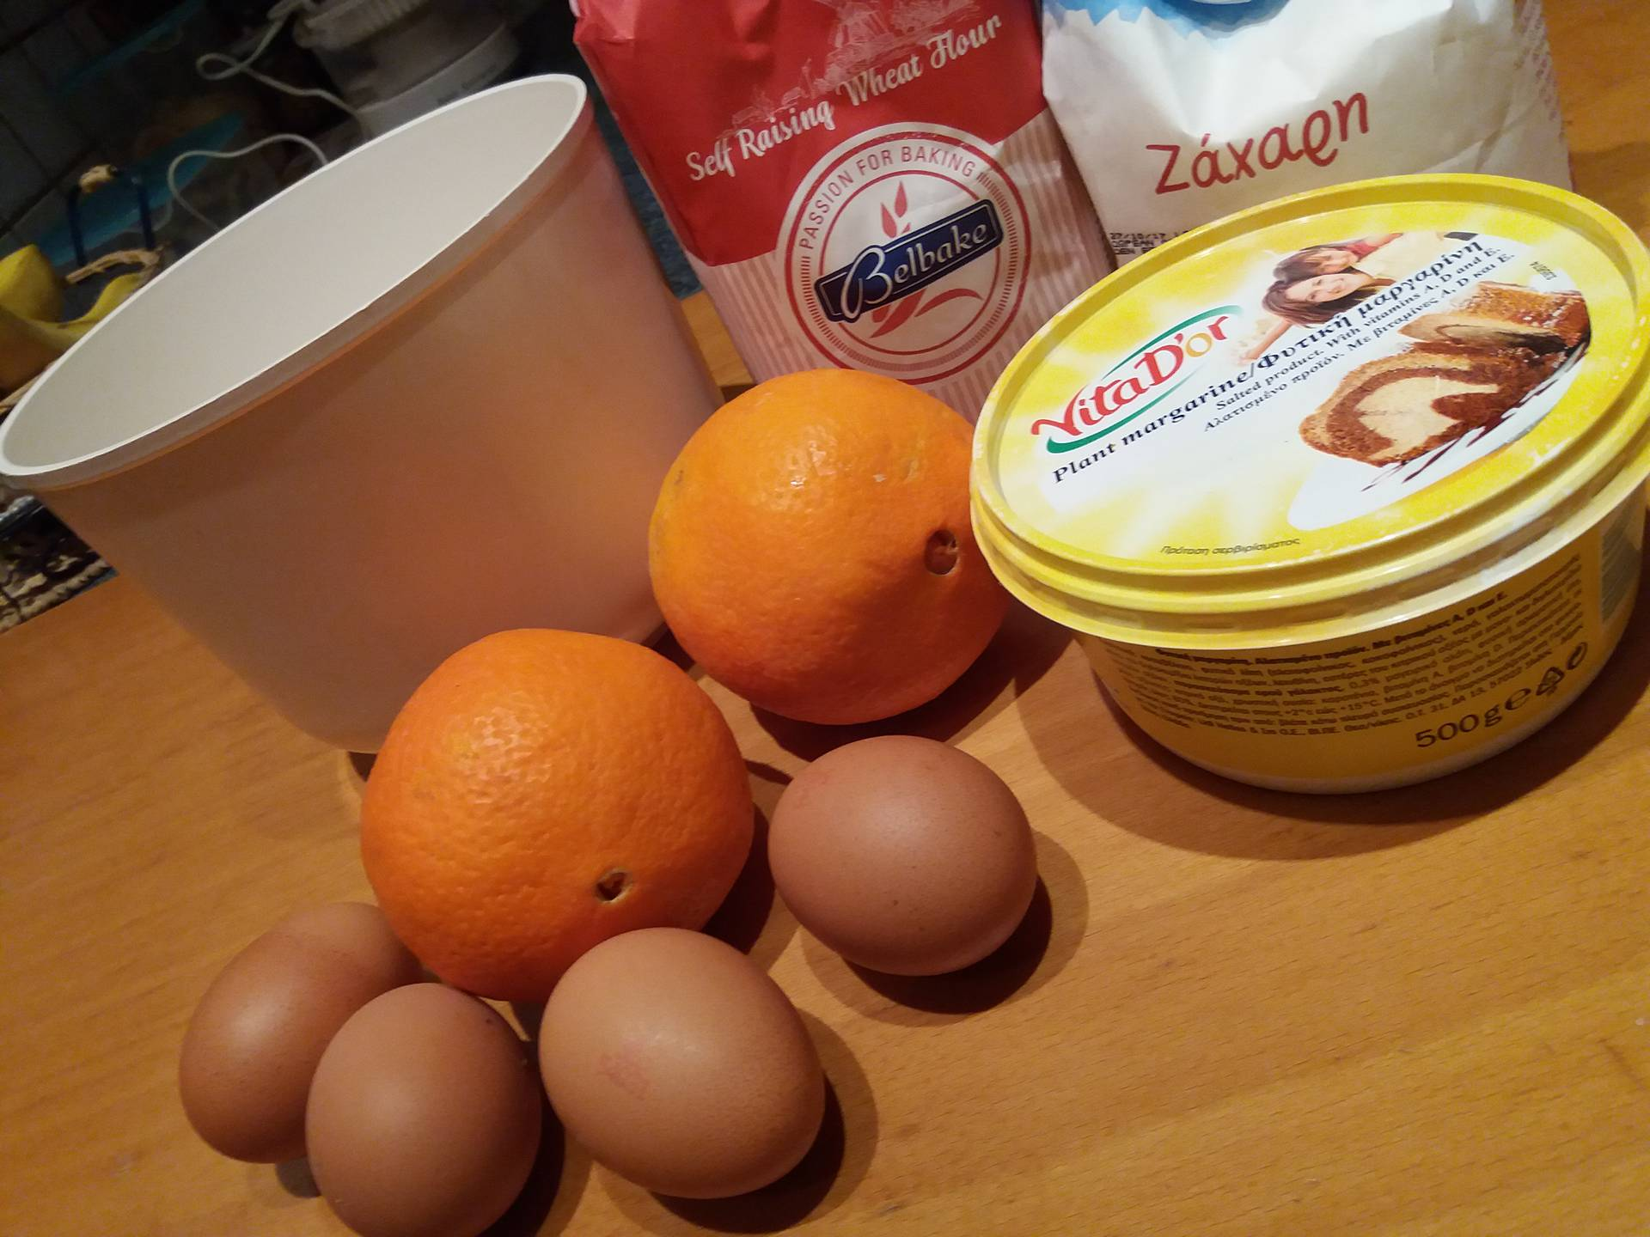
“Cake With Orange Peel”
Ingredients
3 Cups flour (self raising)
2 Cups of sugar
1 Cup of plant margarine
1 Cup of milk
4 Eggs
4 teaspoons of orange peel

Slide 2
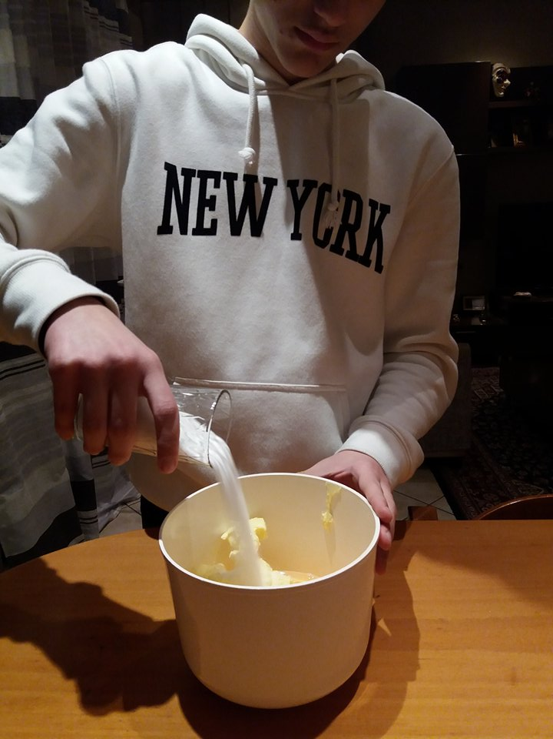
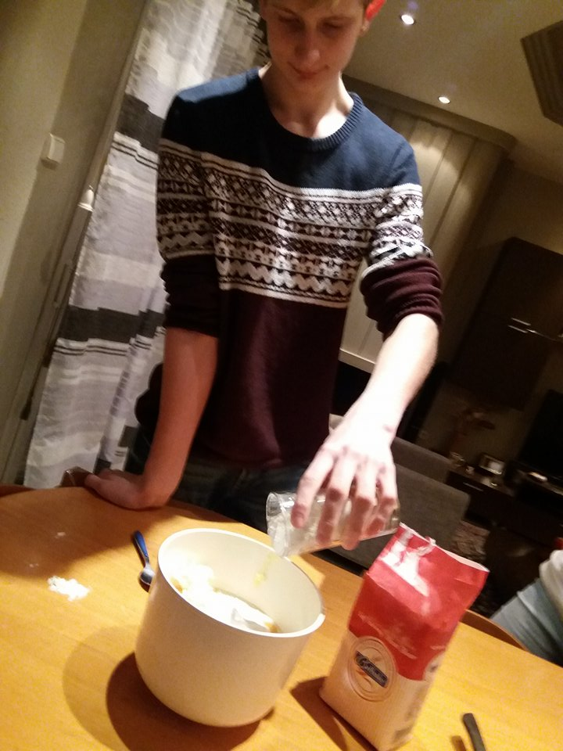
EXECUTION
Beat the ingredients in the mixer for 4 minutes at medium speed until the mixture doubles in volume and becomes fluffy and thick. Butter a mold and flour it. Bake in a preheated oven at 175oC for 1 hour. To make sure it's cooked, dump a knife and come out clean it's ready. When it is cold, sprinkle with powdered sugar.

Slide 3
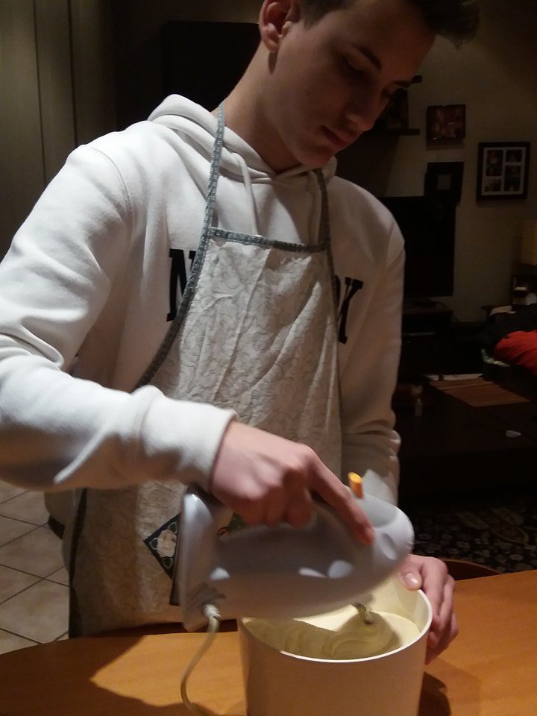
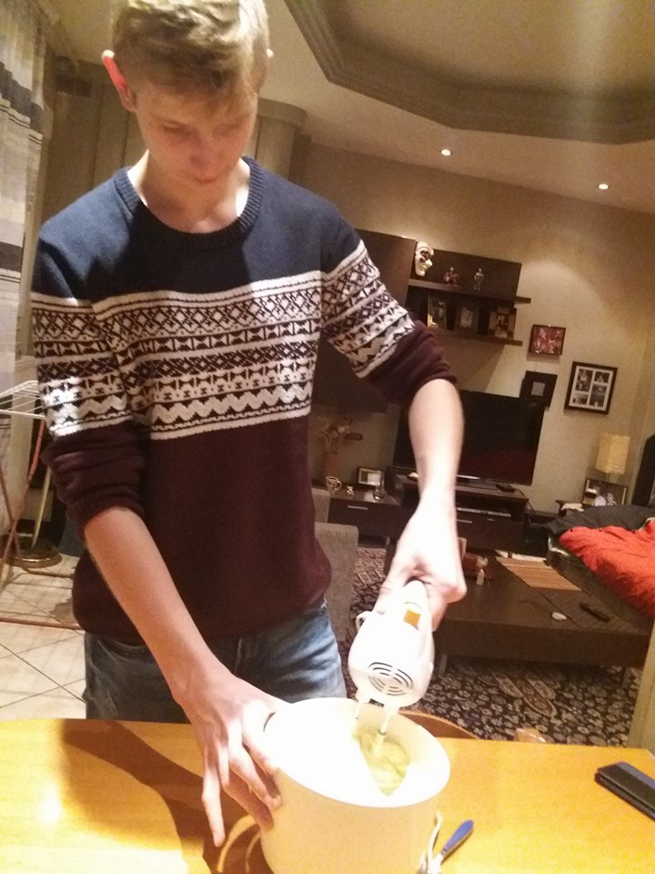

Slide 4
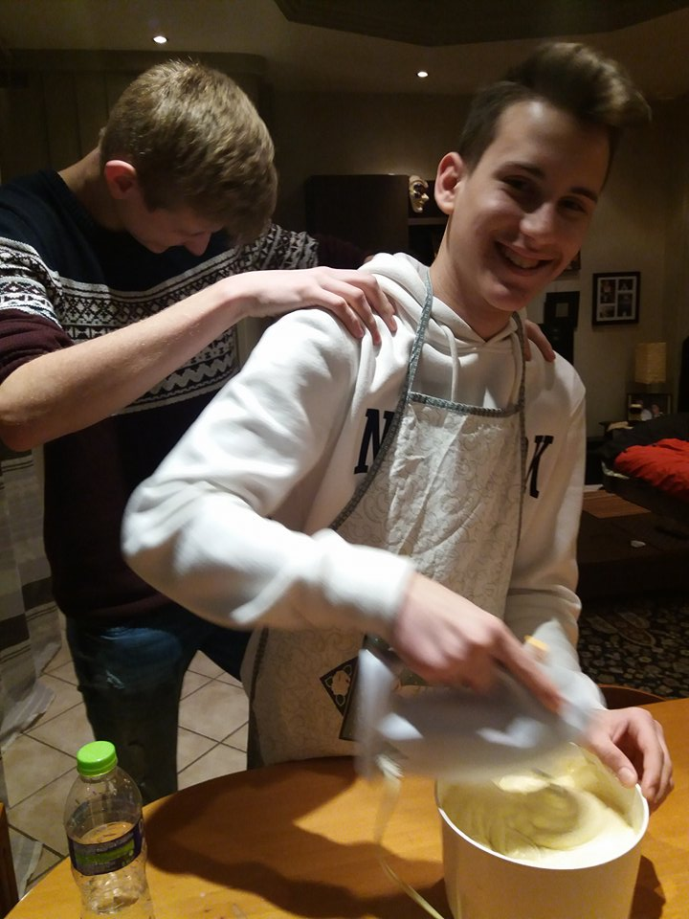
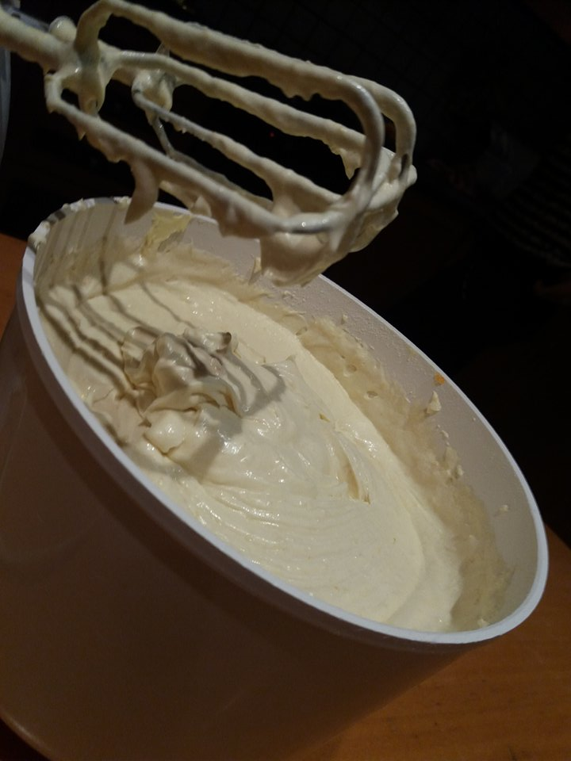

Slide 5
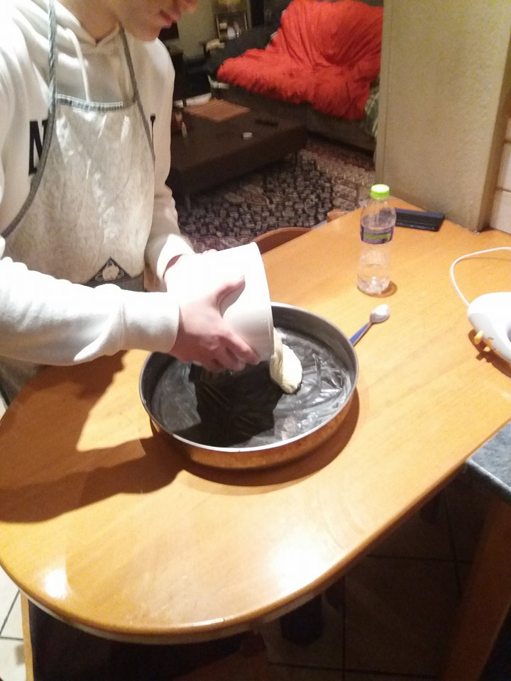
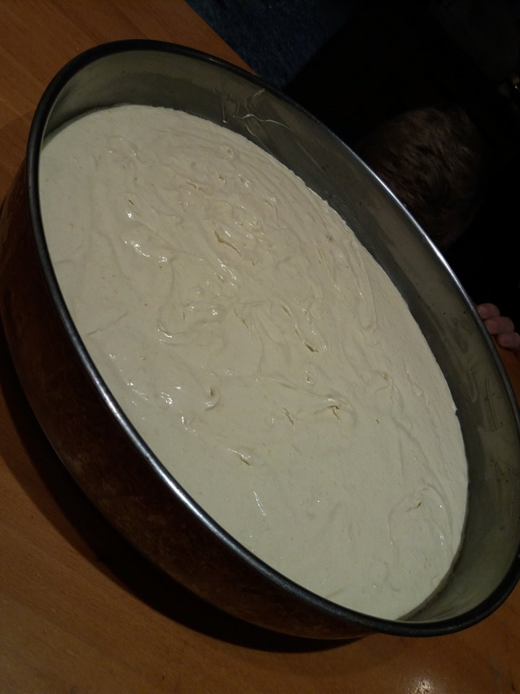

Slide 6
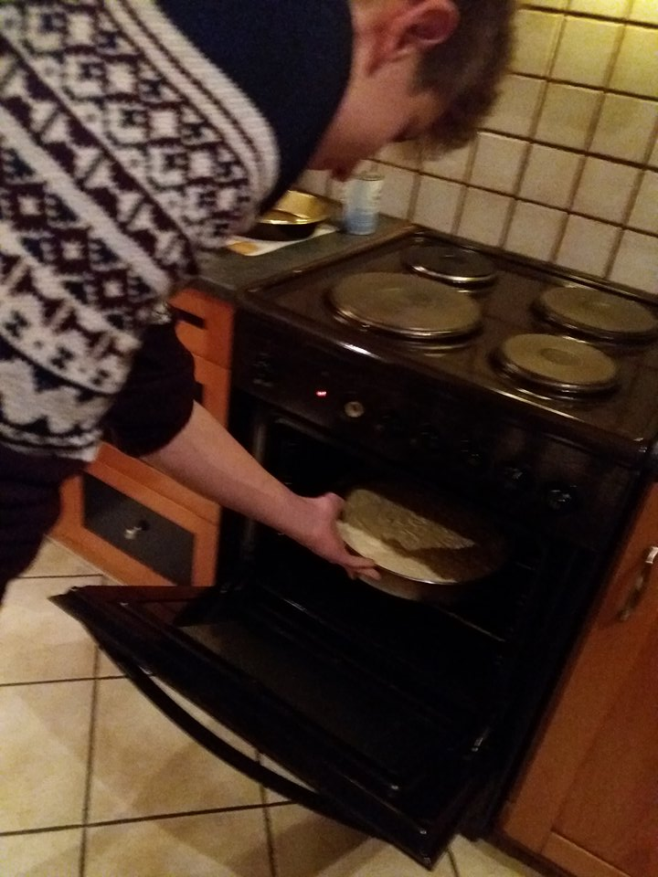
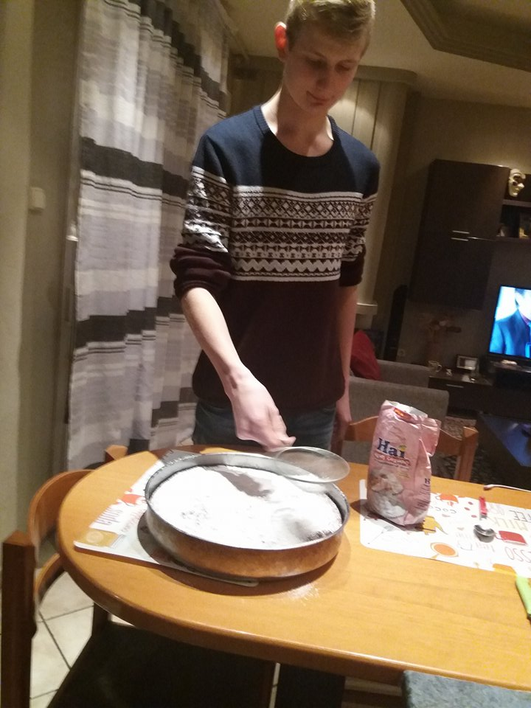

Slide 7
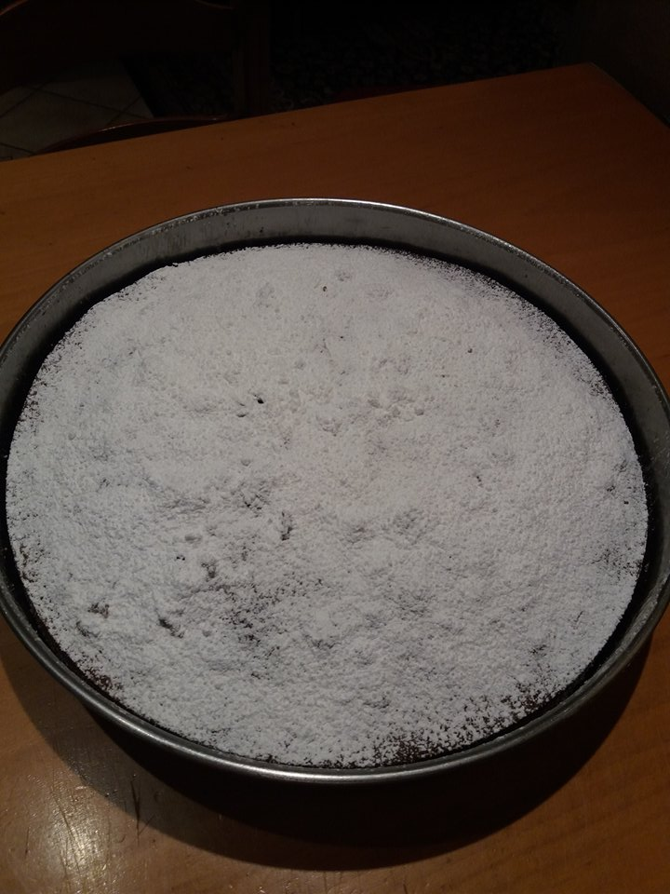
Ready!!

