Slide 1
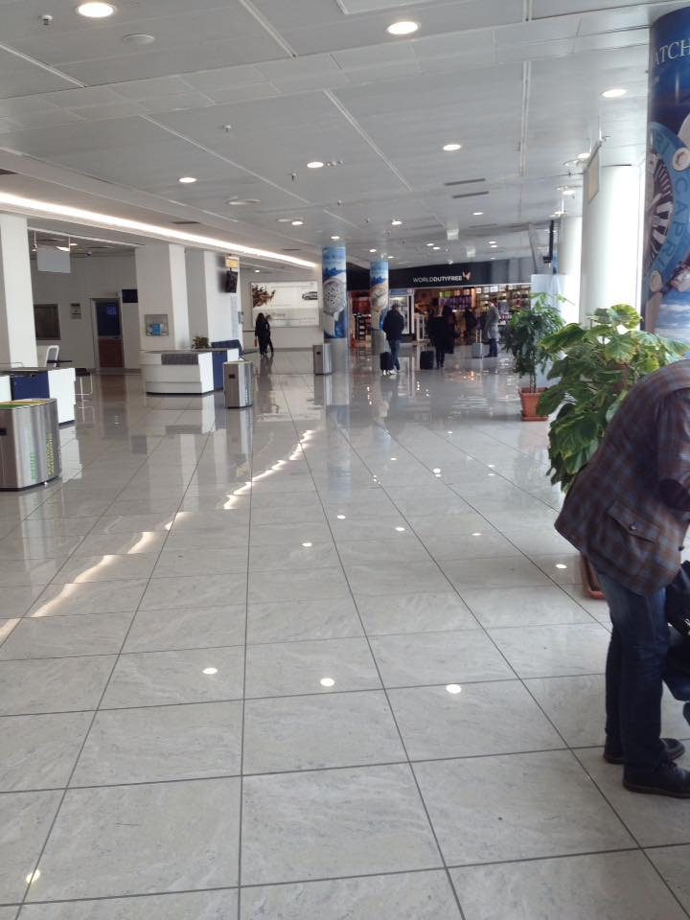
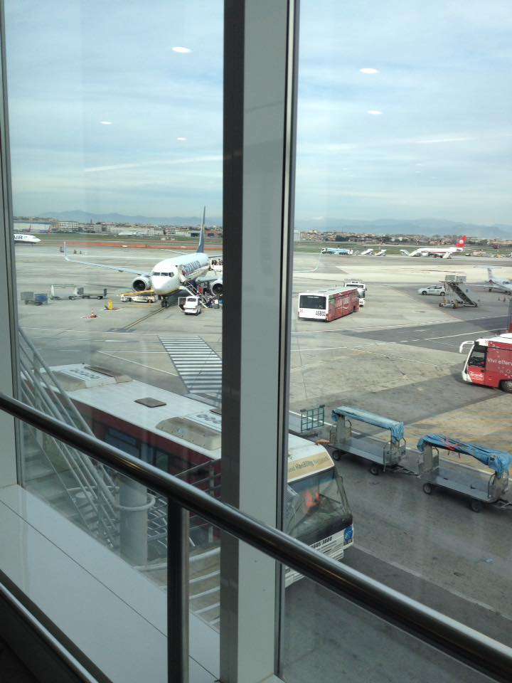
Erasmus+:Essential Life Skills Our week in Greece! The diary about our experience
Sunday
In the morning we went to the airport to meet our teachers, we checked in and we were ready for the journey. It was exciting because it was our first flight. We arrived in Thessaloniki at 6 o’clock in the afteroon and then we took a taxi to get to Volos, the trip was about 2 hours long. In the evening we met the Greek family hosting us: The welcome was fantastic, we were very lucky to be together in the same house and even in the same room!

Slide 2
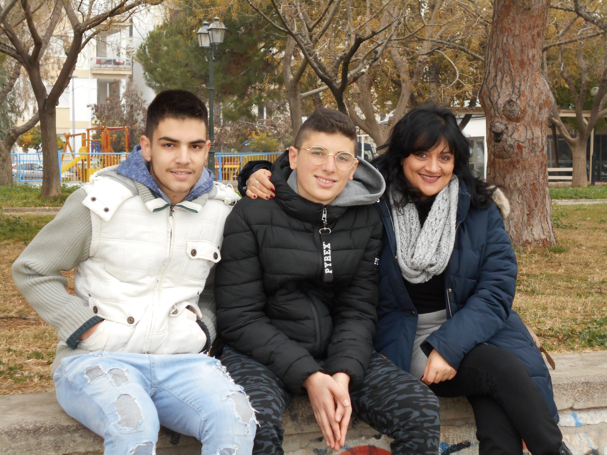
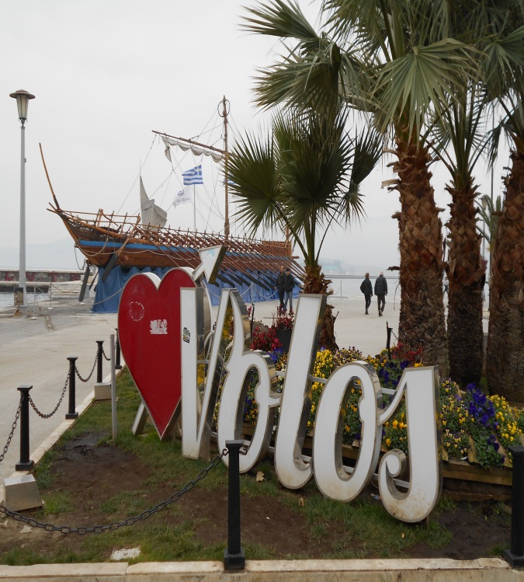
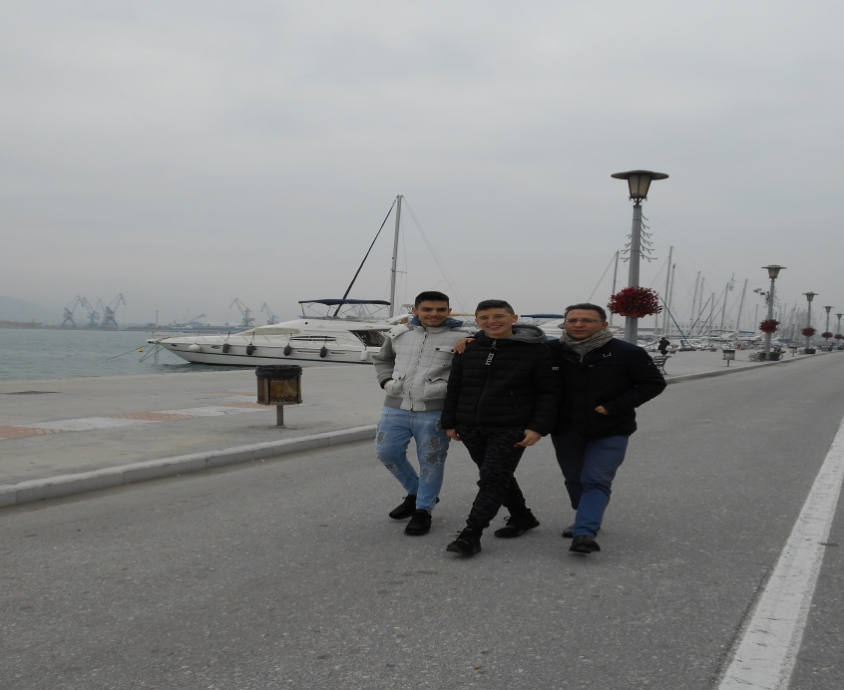
Erasmus+:Essential Life Skills Our week in Greece! The diary about our experience
Monday
We woke up at 9 o’clock and we had breakfast with our Greek family .
Then we met our teachers and visited Volos. We went to a church called St.Costantino and St.Elena and we had a walk by the sea. Later we came back home and we had lunch with the host family. In the afternoon we were at home because we felt a bit worried about the presentation at school the following day. We had dinner in a restaurant with OUR GREEK FAMILY.

Slide 3
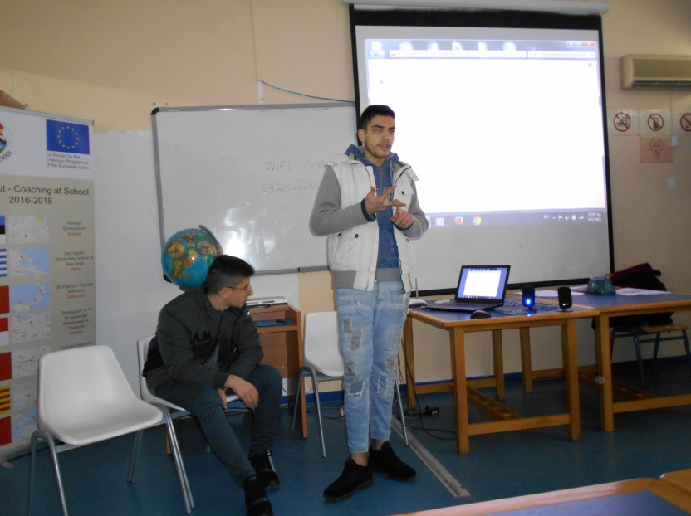
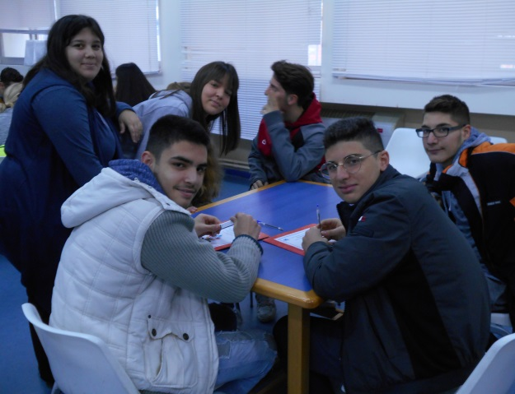
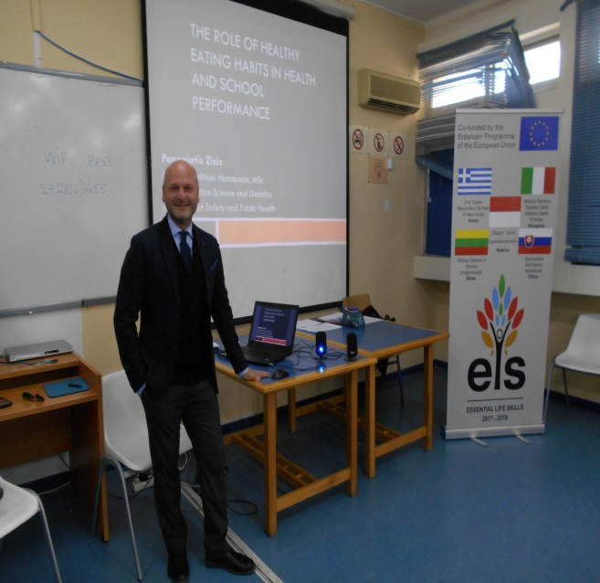
Erasmus+:Essential Life Skills Our week in Greece! The diary about our experience
Tuesday
Our landlady took us to school at 9, a bit later than Greek students. It was an important day as we met all the other students involved in the Erasmus project!
We felt as the protagonists of the day : we had to present ourselves, our school and our city. The same day we took part in a seminary about the «Healthy Eating Habits» with Mr Panagiotis Zisis and after it we had a debate and some questions. In the afternoon we walked around the city with the other guys, we saw the port of Volos, two different churches and many important buildings. But we focused our attention on the castle. In the evening we hung out with other guys to the bowling.

Slide 4
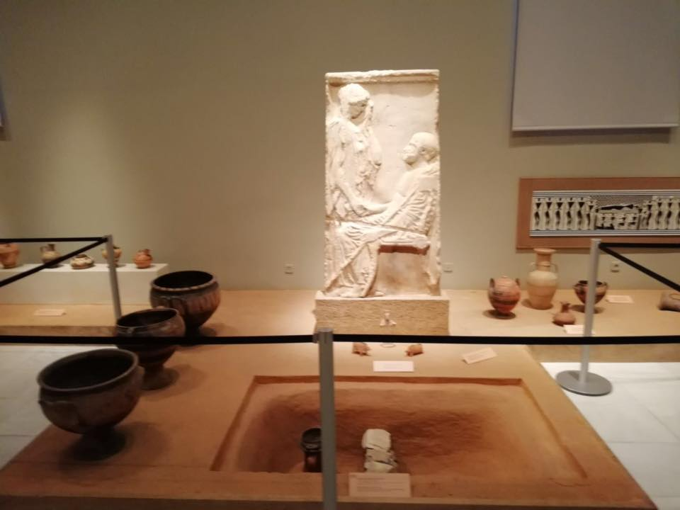
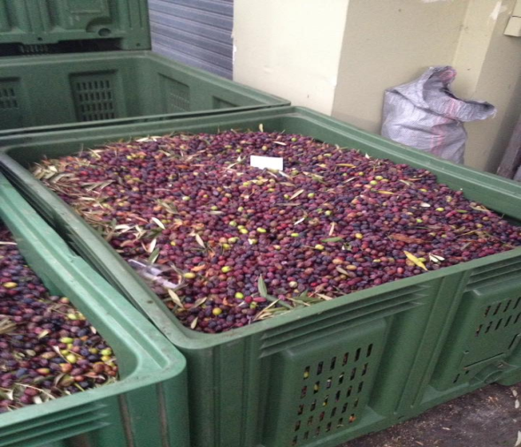
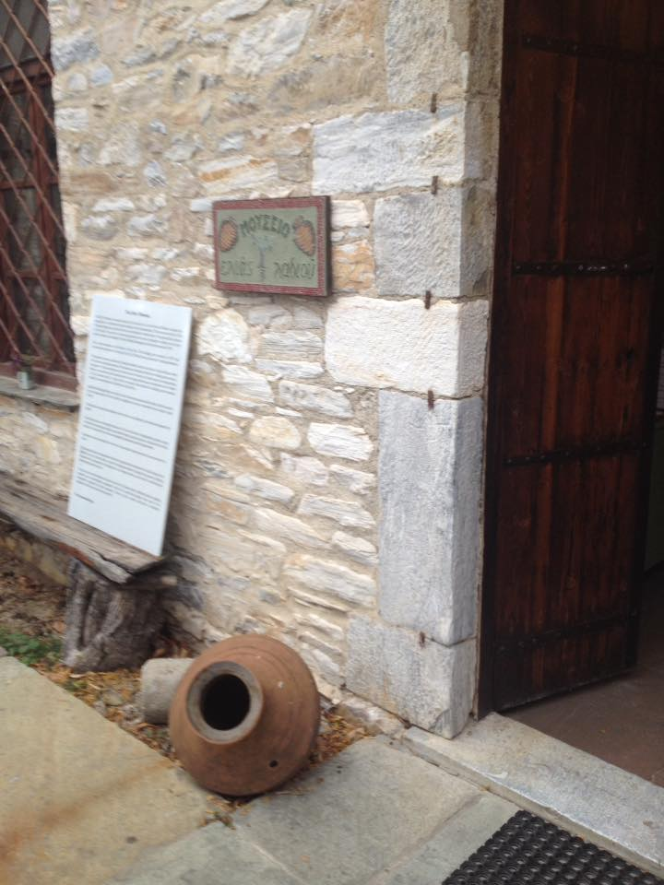
Erasmus+:Essential Life Skills Our week in Greece! The diary about our experience
Wednesday
In the morning we visited the Archeological Museum where we saw old toys and a large quantity of Greek vases and amphorae.It was an interesting experience because we learned a lot about the history of place. In the afternoon we went to the olive oil museum in Ano Gatzea village where we were shown how the greeks make olive oil. Finally we went back home.

Slide 5
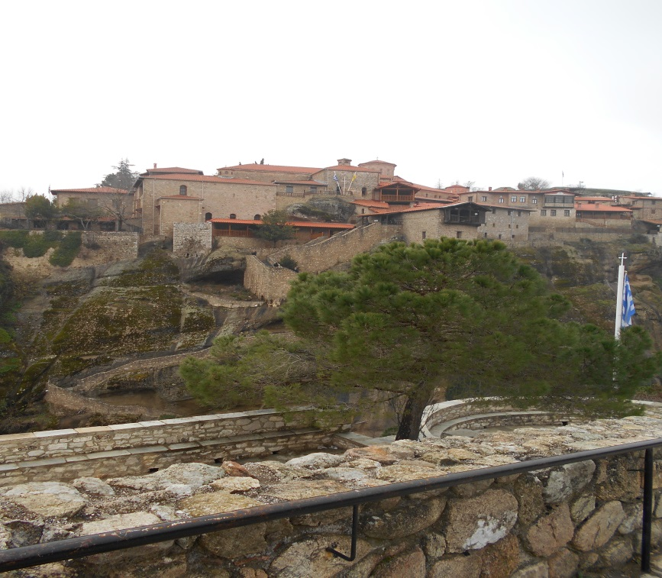
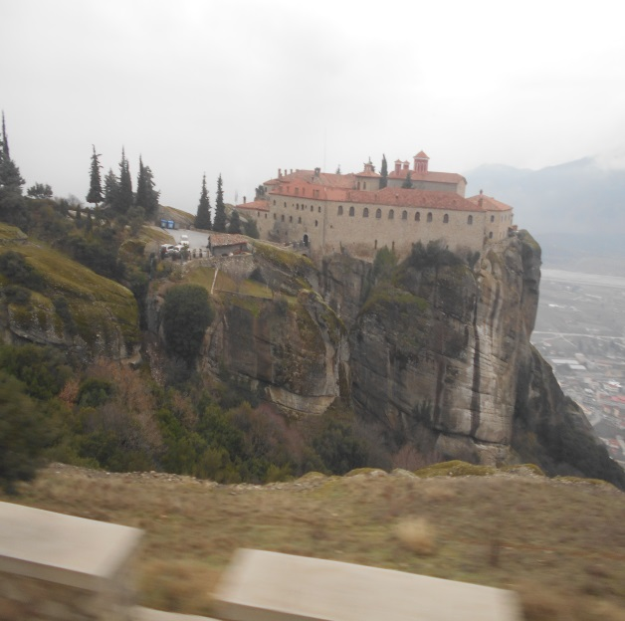
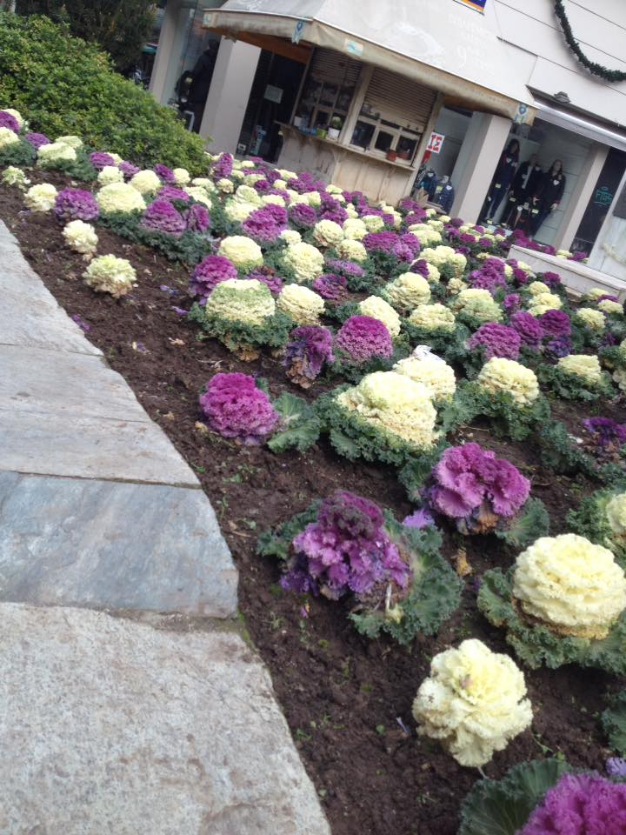
Erasmus+:Essential Life Skills Our week in Greece! The diary about our experience
Thursday
It was a fantastic day as we had a wonderful experience!
We had the opportunity to visit Meteora,particular monasteries in the mountains.It was breathtaking to go there. We could visit two monasteries, The Macedonian School and The Cretan School. In the afternoon we visited Trikala, a very beatiful city and we had lunch in a restaurant.once at home,we started cooking «Italian Freselle» .

Slide 6
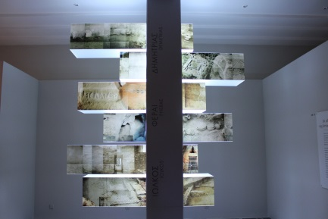
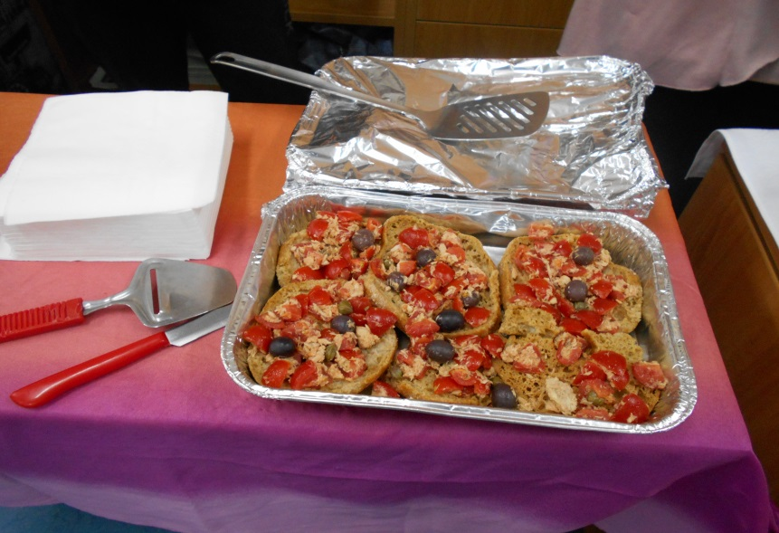
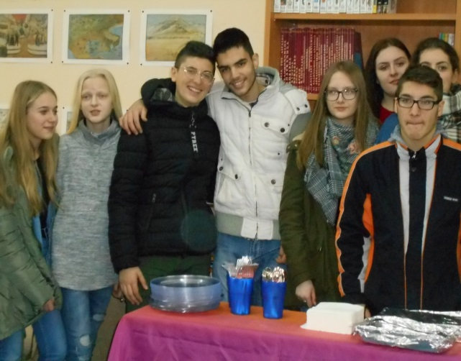
Erasmus+:Essential Life Skills Our week in Greece! The diary about our experience
Friday
In the morning we went to school to show our video about “How to prepare Freselle ”. Then we tasted all the food at school and talked about our experience in Greece . We went back home for lunch. In the afternoon at 6 o’clock we went sightseeing there around.
At 8 o’clock we came back home and later we went to the restaurant for the farewell dinner. It was very funny because we enjoyed the food and had a lot of conversation with the other students.

Slide 7
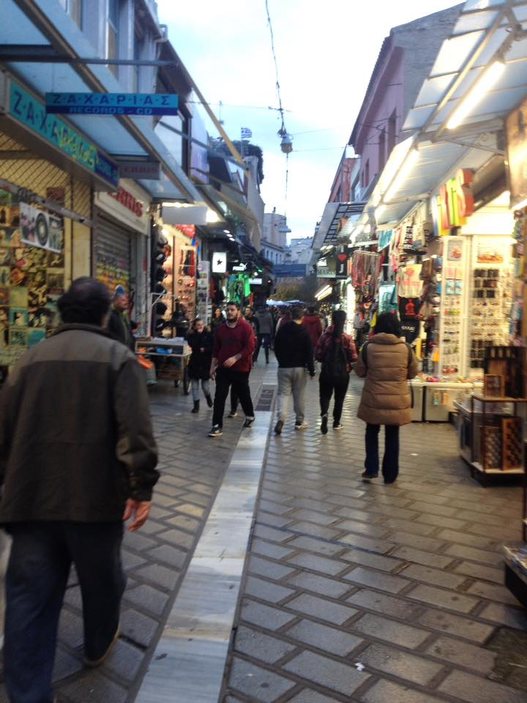
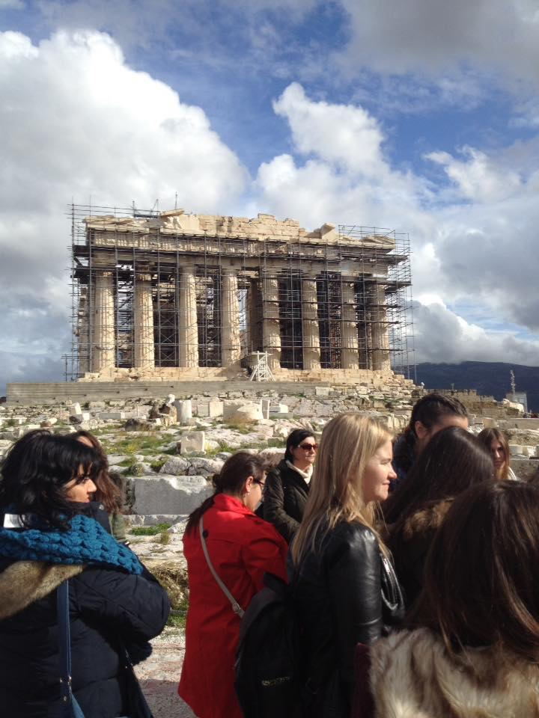
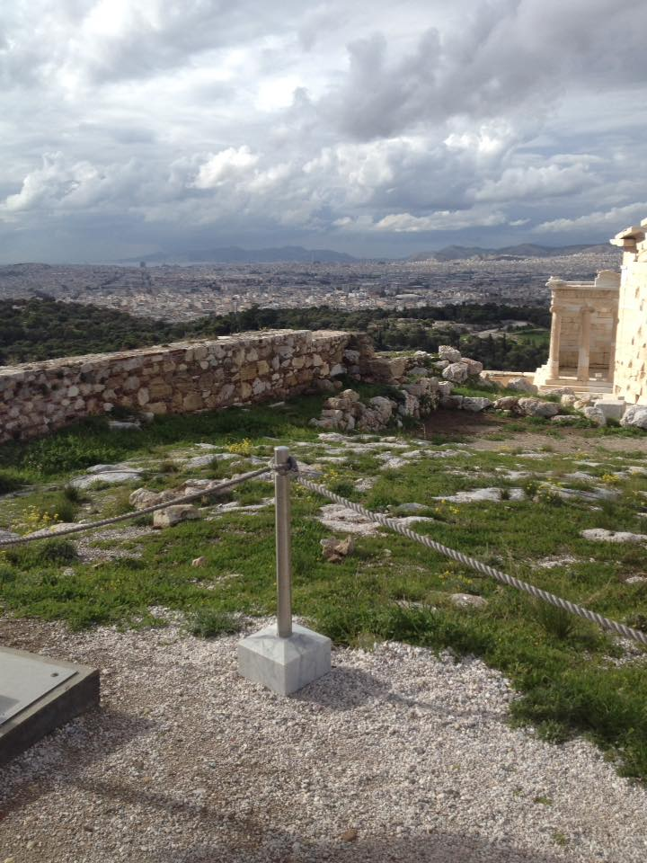
Erasmus+:Essential Life Skills Our week in Greece! The diary about our experience
Saturday
We took a bus to get to Athens to visit the Acropolis and the Parthenon and we arrived there at 12 o’clock .
In the afternoon we had lunch at a restaurant in the main square with our teachers and then we went around for a walk to buy some souvenirs.
It was our last day there, in the evening,sadly, we had to say goodbye to all the partners, OUR EUROPEAN FRIENDS!

Slide 8
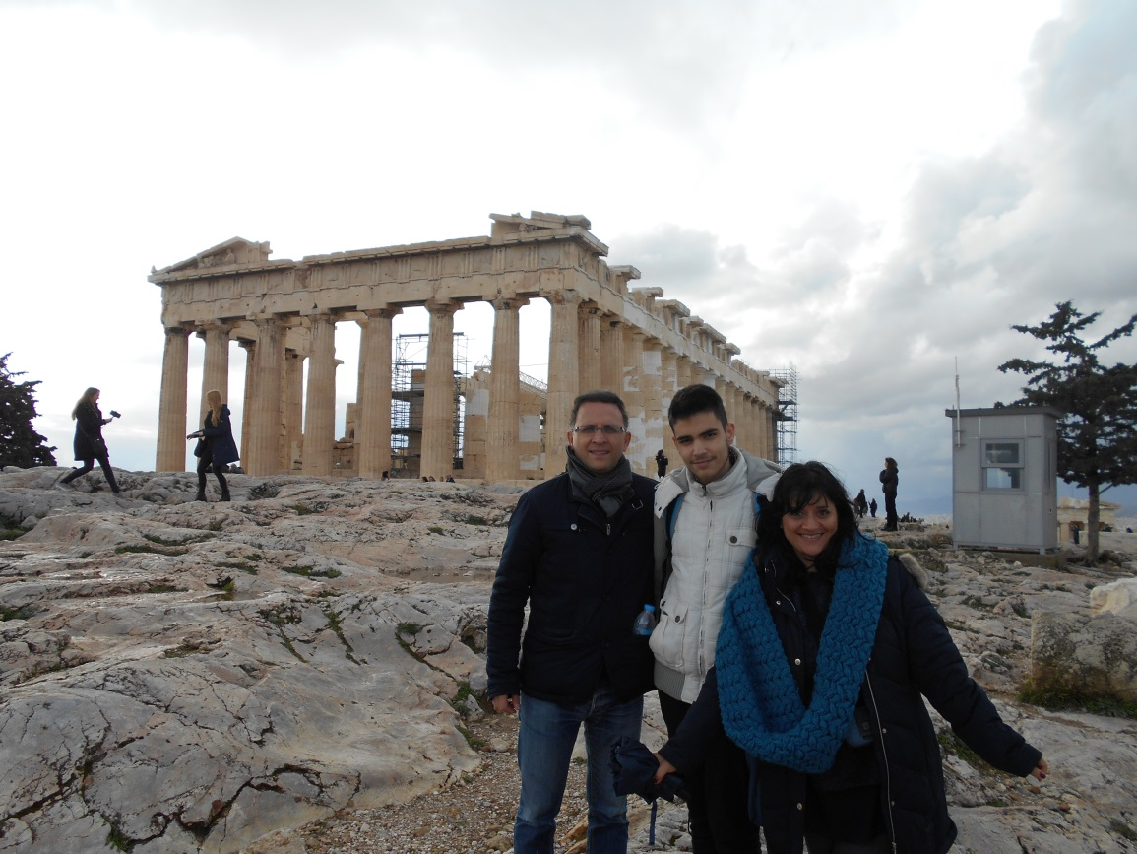
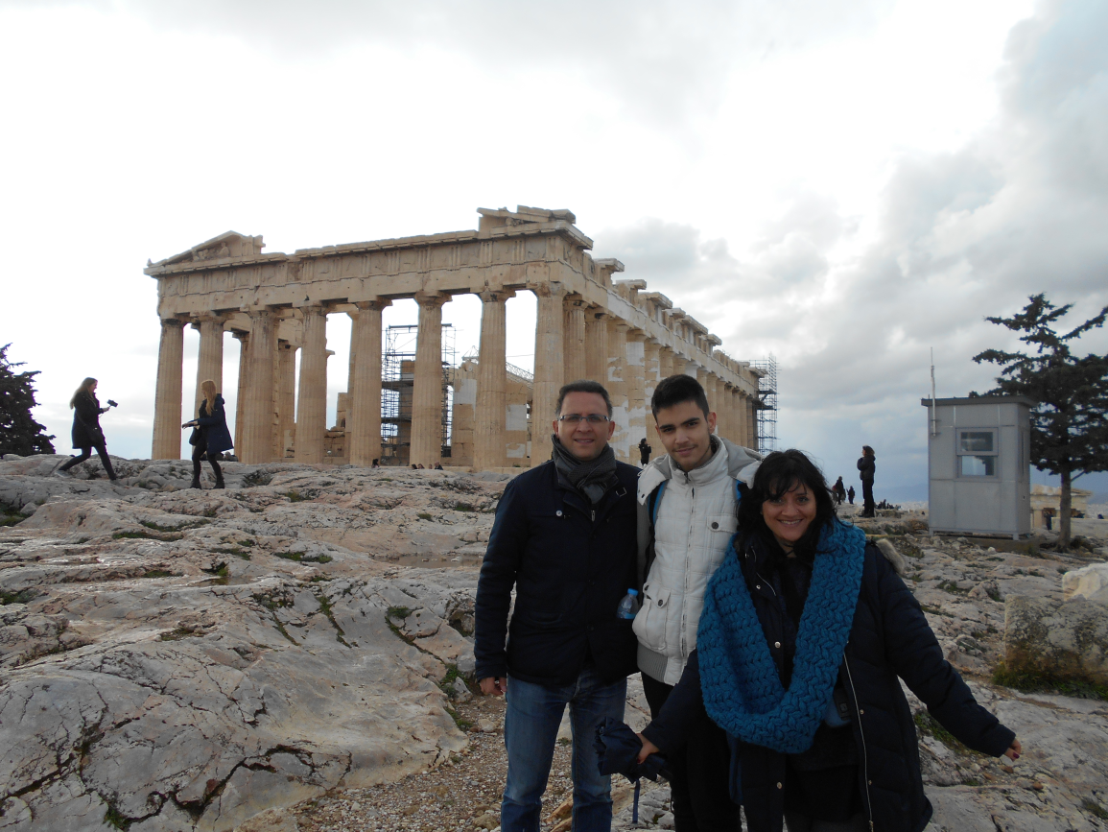
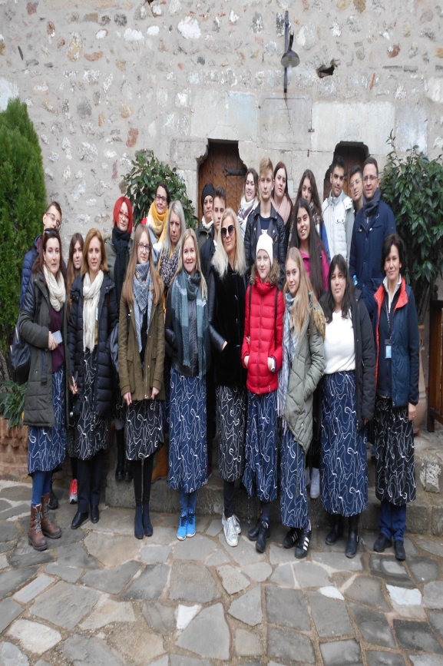
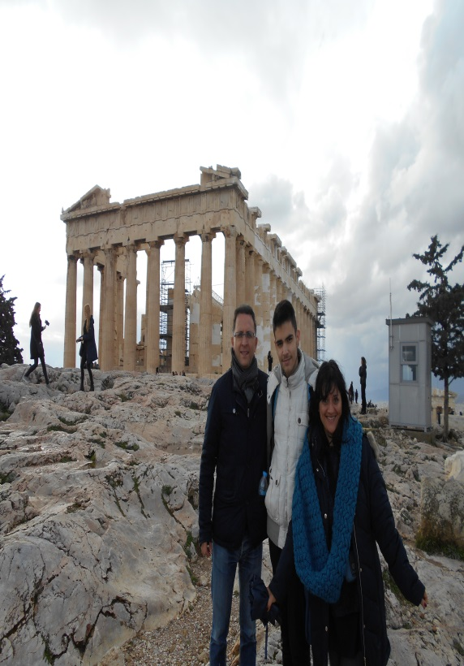
Erasmus+:Essential Life Skills Our week in Greece! The diary about our experience
THE END!
Volos,GREECE

