Slide 1
Manage youR budget
An app to improve Home Economics skills

Slide 2
What’s Home Economics
Individuals and families are continually faced with new and emergent issues that can impact on their wellbeing. Such issues include concerns relating to:
diet and health;
sustainability in the home;
responsible family resource management;
...
Home Economics education uses a systems approach to empower individuals and families with the knowledge and skills to address these real-life concerns of everyday living.
Home Economics education develops students’ essential life skills. It supports the development of students and encourages them to be problem solvers capable of making ethically and socially responsible decisions.

Slide 3
Goals
To give opportunities to acquire the knowledge and to develop the skills required for organization and management of resources.
To strengthen student's daily life experience and to stimulate ideas of creativity.
To develop students' individual capability by encouraging practical application of knowledge and problem-solving tasks.
To share experience, materials, tools and equipment with others.

Slide 4
Contents
In this lesson we will learn how to realize an app to manage the family budget.
The development environment: MIT App Inventor
How to realize an app
The Budget app

Slide 5
MIT App Inventor: background
MIT App Inventor is a project of Massachusetts Institute of Technology
MIT App Inventor is an intuitive, visual programming environment that allows everyone to build fully functional apps for smartphones and tablets.

Slide 6
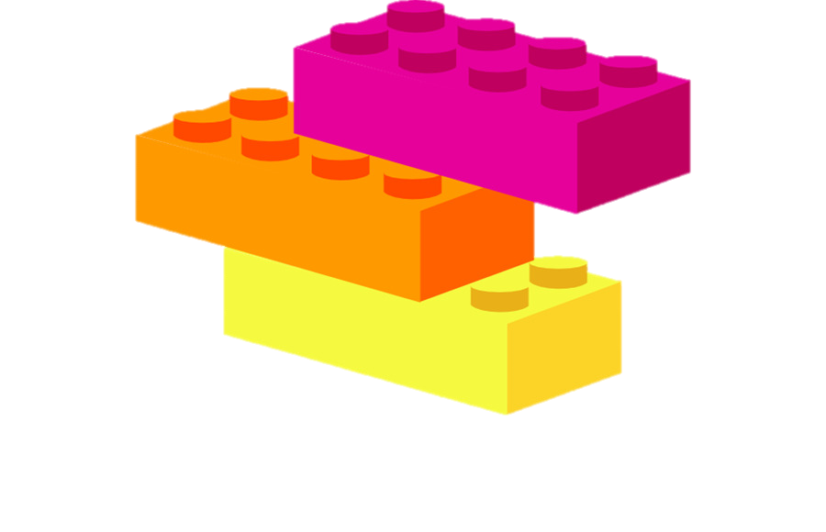
WHY MIT App Inventor
The blocks-based tool facilitates the creation of complex, high-impact apps in significantly less time than traditional programming environments. The MIT App Inventor project seeks to democratize software development by empowering all people, especially young people, to move from technology consumption to technology creation.
Moreover, this tool also promotes the computational thinking approch

Slide 7
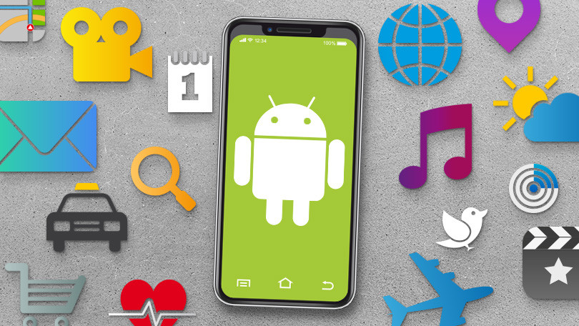
And now….let’s discover how to create an app….

Slide 8
MIT App Inventor: how to start
In order to start realizing a project, it is enough to have a google e-mail account and then to go to the address:
http://appinventor.mit.edu/explore/
To begin creating an App it’s enough to click on

Slide 9
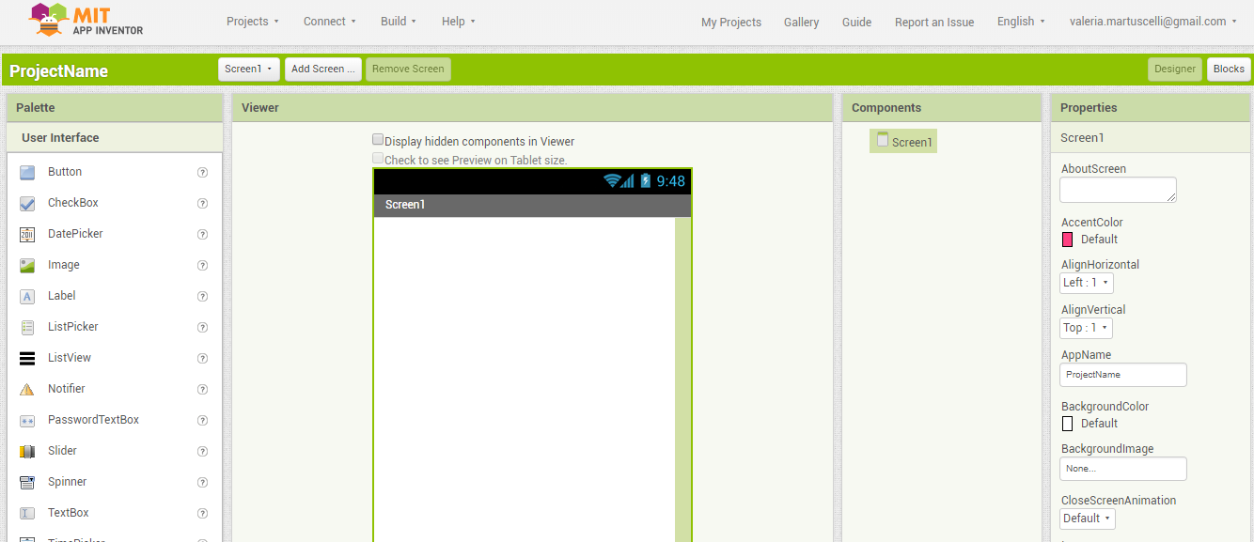
MIT APP INVENTOR: THE work environment

Slide 10
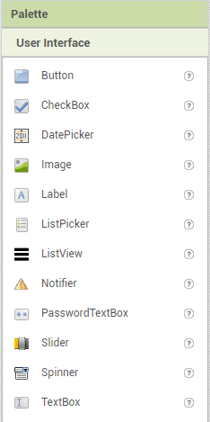
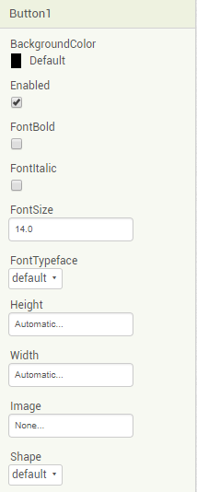
properties
Elements

Slide 11
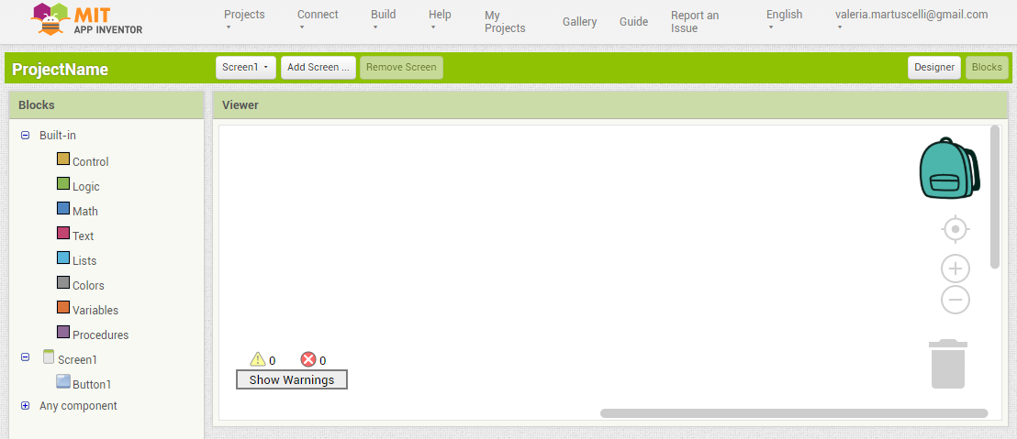
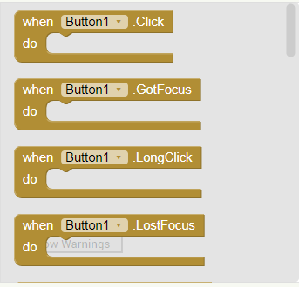
The block based tool

Slide 12
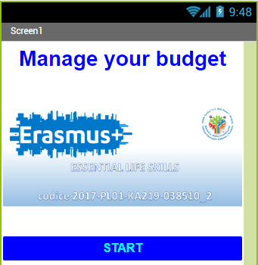
The budget app

Slide 13
To manage a family budget it is needed to keep trace of
Incoming +
Expenses -
Balance = Sum Incoming – Sum Expenses

Slide 14
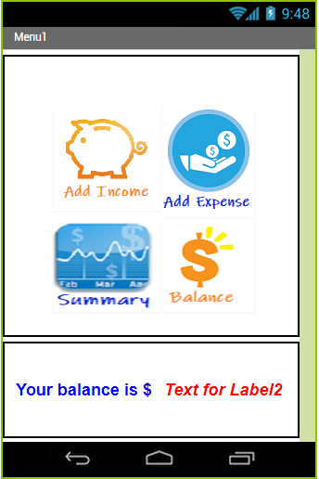
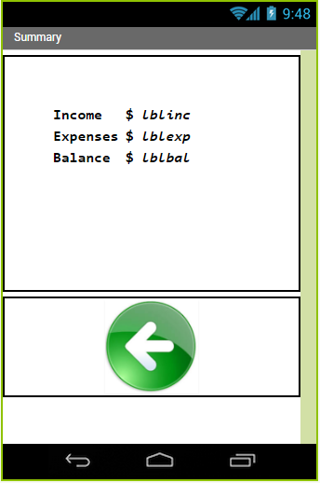
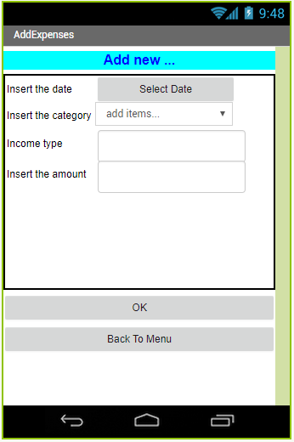

Slide 15
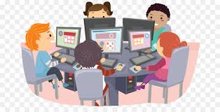
Now it’s your turn….

Slide 16
http://appinventor.mit.edu
Studentka2.2018.1
Studentka2.2018.2
Studentka2.2018.3
Studentka2.2018.4
Password_1

